Slide 1

TEAM MEMBER : JUN HAO(DESIGNER) ALEX(PROGRAMMER) YI FANG(PROGRAMMER) GIM HSIANG(PRODUCER)
Notes:
g

Slide 2
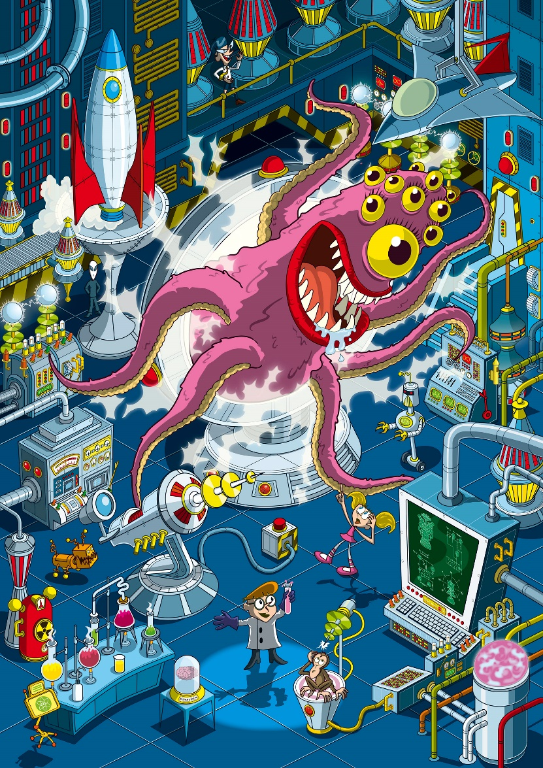
Game Concept
ANIMAL EXPERIMENT ESCAPEE
YOU CAN CONTROL ENEMIES!
OUCH! IS A 2D PUZZLE GAME WHERE THE LAB SPECIMENS ESCAPE THE LABORATORY.
Notes:
yf

Slide 3


CORE FEATURES
NAVIGATION | PUZZLE | ESCAPE | SCI-FI | NARRATIVE
Monkey (Possession other animals)
Rhino (Destroy some obstacles)
Bear (Push obstacles)
Notes:
jun hao

Slide 4
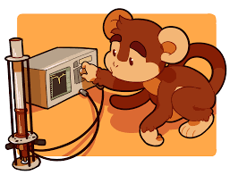
Game Showcase
Notes:
g

Slide 5
Learning points
Teamwork & Communication is key
Time management
We learnt how to use file I/O
Framework
Level design
Notes:
alex

Slide 6
Thank you!
Notes:
g

